Slide 1
Booking a service through the Therapists Template while logged in
Click to start presentation

Slide 2



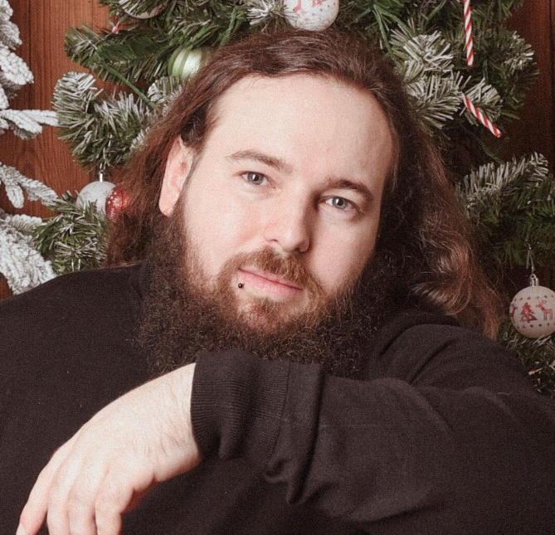

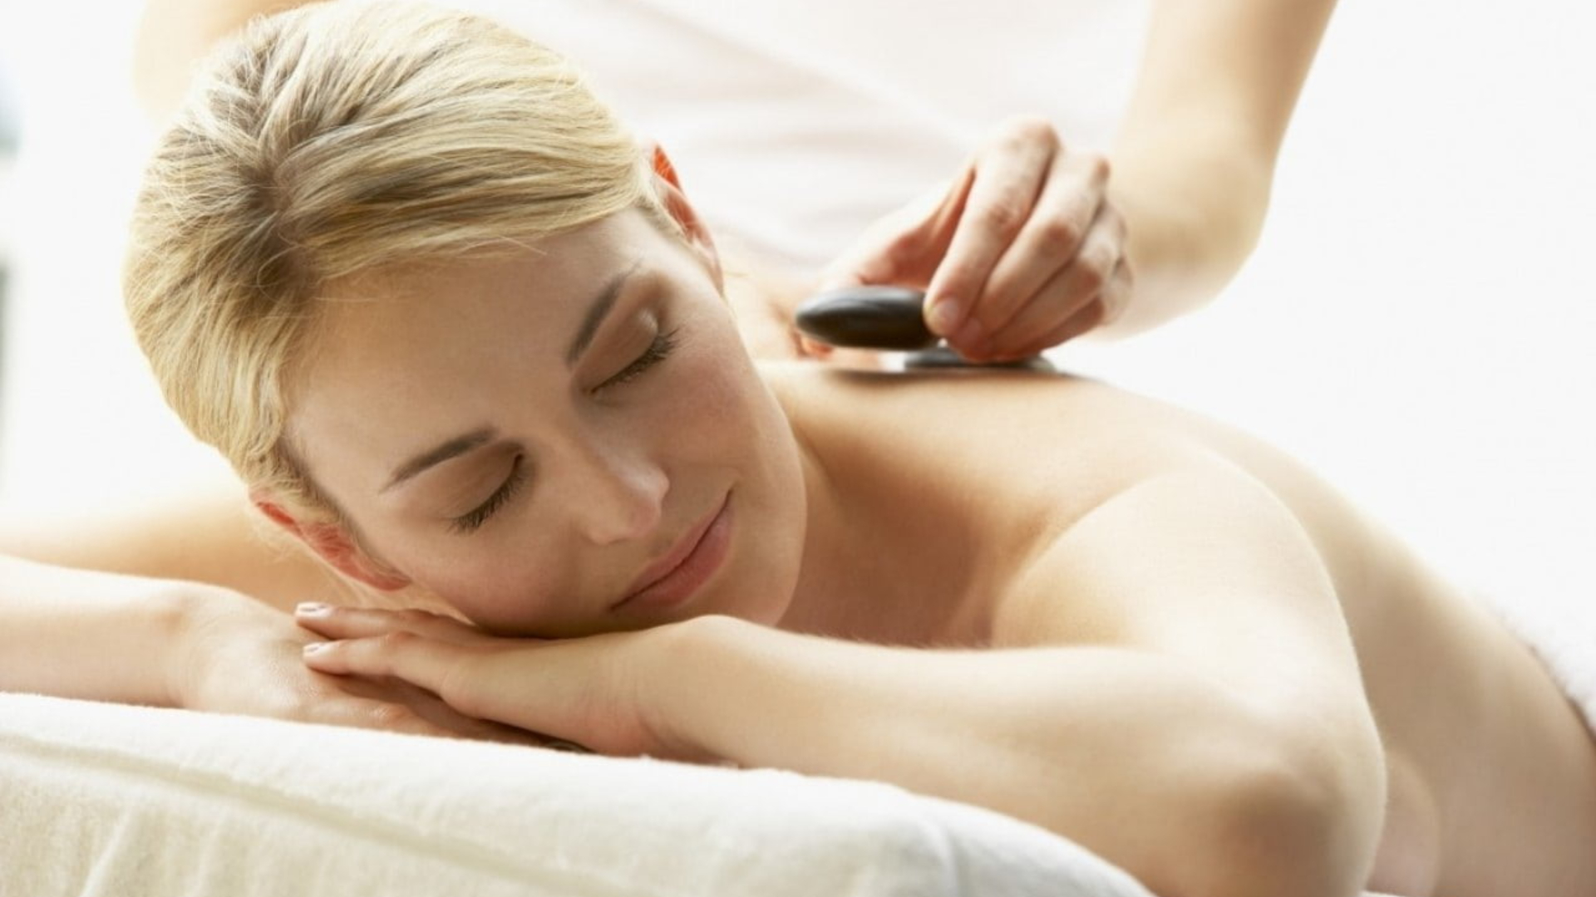
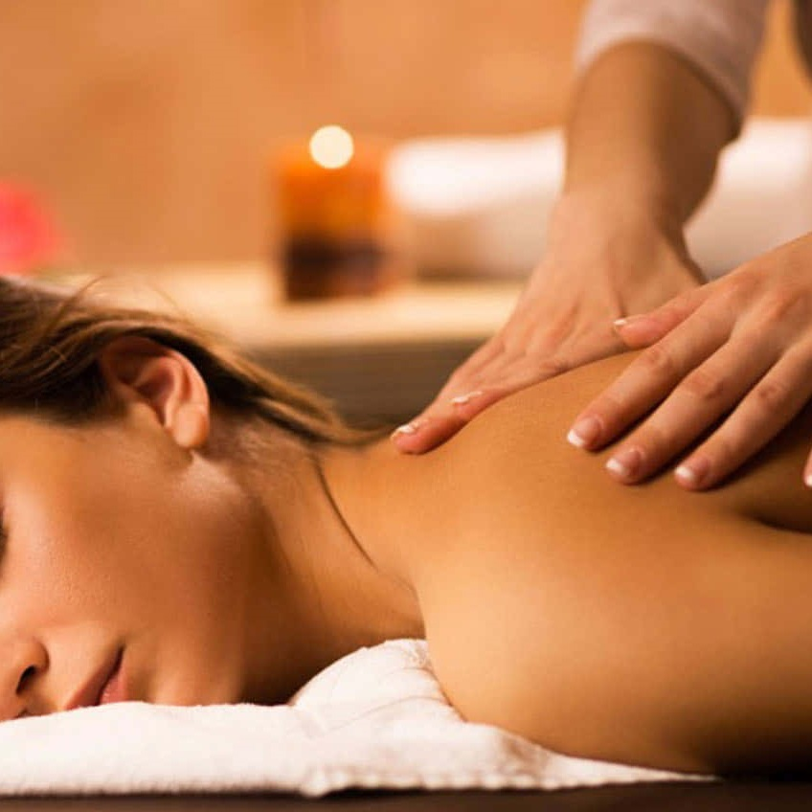
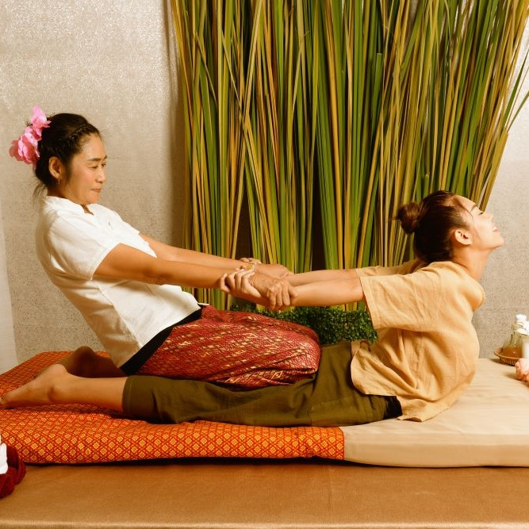
Home
Therapists
Book now
About us
Contacts
Profile
Sign out
Roger Iskrenov
Verified practitioner pronouns: He/Him Field and specialty: Personal yoga trainer
Certifications & Training:
Licensed Massage Therapist (LMT)
Certified Yoga Instructor (RYT-500)
Specializations: Deep Tissue, Myofascial Release, Thai Yoga Massage
"Hi, I’m a certified massage therapist and personal yoga trainer with over 10 years of experience helping clients achieve balance, relaxation, and well-being. My holistic approach combines therapeutic massage techniques with personalized yoga sessions to bring harmony to body and mind."
Gallery
Services

Slide 3
Home
Therapists
Book now
About us
Contacts
Profile
Sign out
Germany Mobile Spa
Roger Iskrenov
Verified practitioner pronouns: He/Him Field and specialty: Personal yoga trainer
Certifications & Training:
Licensed Massage Therapist (LMT)
Certified Yoga Instructor (RYT-500)
Specializations: Deep Tissue, Myofascial Release, Thai Yoga Massage
"Hi, I’m a certified massage therapist and personal yoga trainer with over 10 years of experience helping clients achieve balance, relaxation, and well-being. My holistic approach combines therapeutic massage techniques with personalized yoga sessions to bring harmony to body and mind."
Gallery
Services

Slide 4
Home
Therapists
Book now
About us
Contacts
Profile
Sign out
Germany Mobile Spa
Roger Iskrenov
Verified practitioner pronouns: He/Him Field and specialty: Personal yoga trainer
Certifications & Training:
Licensed Massage Therapist (LMT)
Certified Yoga Instructor (RYT-500)
Specializations: Deep Tissue, Myofascial Release, Thai Yoga Massage
"Hi, I’m a certified massage therapist and personal yoga trainer with over 10 years of experience helping clients achieve balance, relaxation, and well-being. My holistic approach combines therapeutic massage techniques with personalized yoga sessions to bring harmony to body and mind."
Gallery
Services
Services
Our practitioners are available daily from 8.00am until 7.00pm. If requiring services after 7.00pm additional 200 Baht/hour will be added to each service.
Thai Massage
Experience the ancient art of Thai massage. A therapeutic practice that combines gentle stretching, acupressure, and rhythmic movements. This full-body treatment promotes flexibility, relieves tension, and restores balance, leaving you refreshed and rejuvenated.
60 minutes: 25.00 € 90 minutes: 35.00 €
Relaxing Oil Massage
Deep Tissue Massage
Slimming Massage
Jet Lag Massage
Myofascial Massage
Pregnancy Massage
Foot Massage
Foot Scrub
Body Scrub
Facial Treatment
Yoga Personal Trainer
Manicure
Book
Pedicure
Book

Slide 5
Roger Iskrenov
Verified practitioner pronouns: He/Him Field and specialty: Personal yoga trainer
Certifications & Training:
Licensed Massage Therapist (LMT)
Certified Yoga Instructor (RYT-500)
Specializations: Deep Tissue, Myofascial Release, Thai Yoga Massage
"Hi, I’m a certified massage therapist and personal yoga trainer with over 10 years of experience helping clients achieve balance, relaxation, and well-being. My holistic approach combines therapeutic massage techniques with personalized yoga sessions to bring harmony to body and mind."
Gallery
Services
Home
Therapists
Book now
About us
Contacts
Profile
Sign out
Germany Mobile Spa
Services
Our practitioners are available daily from 8.00am until 7.00pm. If requiring services after 7.00pm additional 200 Baht/hour will be added to each service.
Thai Massage
Experience the ancient art of Thai massage. A therapeutic practice that combines gentle stretching, acupressure, and rhythmic movements. This full-body treatment promotes flexibility, relieves tension, and restores balance, leaving you refreshed and rejuvenated.
60 minutes: 25.00 € 90 minutes: 35.00 € 120 minutes: 45.00 €
Relaxing Oil Massage
Deep Tissue Massage
Slimming Massage
Jet Lag Massage
Myofascial Massage
Pregnancy Massage
Foot Massage
Foot Scrub
Body Scrub
Facial Treatment
Yoga Personal Trainer
Book
Manicure
Pedicure

Slide 6
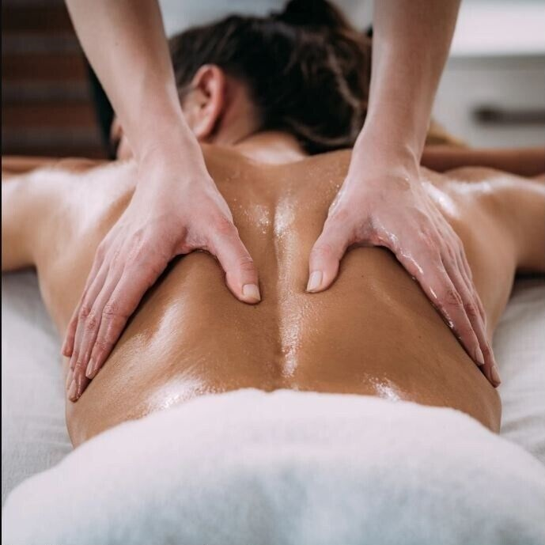
Home
Therapists
Book now
About us
Contacts
Profile
Sign out
Germany Mobile Spa
Services
Our practitioners are available daily from 8.00am until 7.00pm. If requiring services after 7.00pm additional 200 Baht/hour will be added to each service.
Thai Massage
Indulge in a Relaxing Oil Massage, designed to melt away stress and soothe your senses. Smooth, flowing strokes with aromatic oils ease muscle tension, enhance circulation, and promote deep relaxation, leaving you feeling calm, refreshed, and rejuvenated.
60 minutes: 25.00 € 90 minutes: 35.00 € 120 minutes: 45.00 €
Relaxing Oil Massage
Deep Tissue Massage
Slimming Massage
Jet Lag Massage
Myofascial Massage
Pregnancy Massage
Foot Massage
Foot Scrub
Body Scrub
Facial Treatment
Yoga Personal Trainer
Book
Manicure
Pedicure

Slide 7
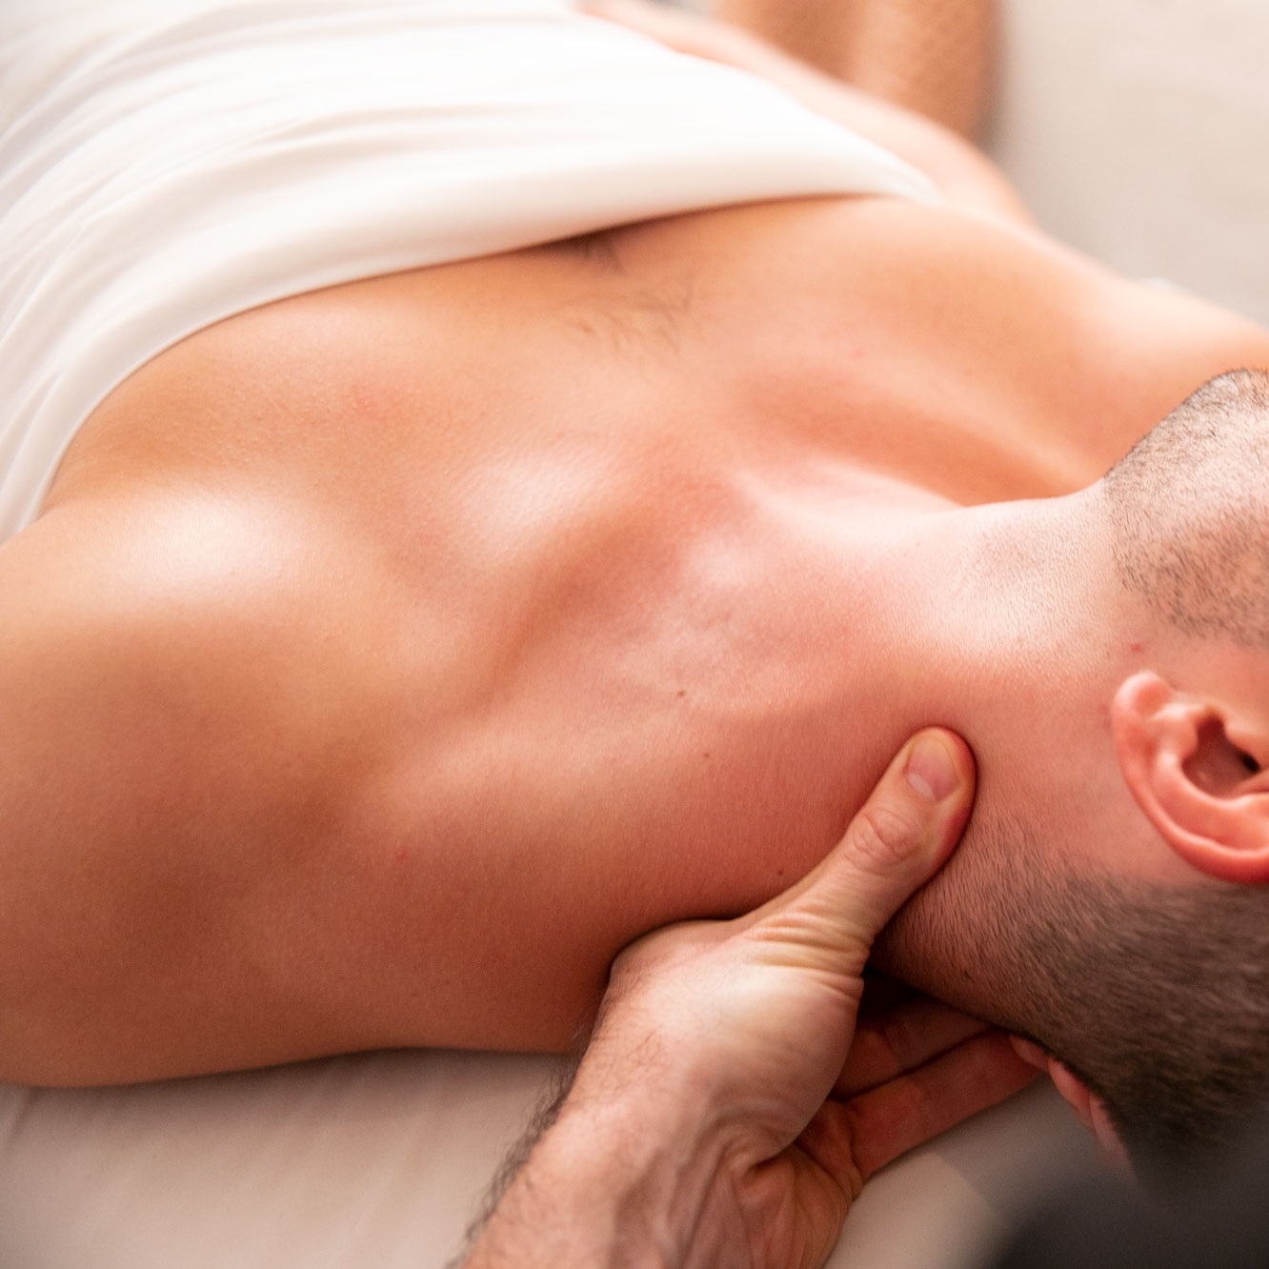
Home
Therapists
Book now
About us
Contacts
Profile
Sign out
Germany Mobile Spa
Services
Our practitioners are available daily from 8.00am until 7.00pm. If requiring services after 7.00pm additional 200 Baht/hour will be added to each service.
Thai Massage
The rejuvenating power of a Deep Tissue Massage, targeting deeper layers of muscle and connective tissue. With firm pressure and focused techniques, this treatment relieves chronic tension, eases tightness, and promotes recovery, leaving you feeling restored and revitalized.
60 minutes: 35.00 € 90 minutes: 50.00 € 120 minutes: 65.00 €
Relaxing Oil Massage
Deep Tissue Massage
Slimming Massage
Jet Lag Massage
Myofascial Massage
Pregnancy Massage
Foot Massage
Foot Scrub
Body Scrub
Facial Treatment
Yoga Personal Trainer
Book
Manicure
Pedicure

Slide 8
Home
Therapists
Book now
About us
Contacts
Profile
Sign out
Germany Mobile Spa
Services
Our practitioners are available daily from 8.00am until 7.00pm. If requiring services after 7.00pm additional 200 Baht/hour will be added to each service.
Thai Massage
The rejuvenating power of a Deep Tissue Massage, targeting deeper layers of muscle and connective tissue. With firm pressure and focused techniques, this treatment relieves chronic tension, eases tightness, and promotes recovery, leaving you feeling restored and revitalized.
60 minutes: 35.00 € 90 minutes: 50.00 € 120 minutes: 65.00 €
Relaxing Oil Massage
Deep Tissue Massage
Slimming Massage
Jet Lag Massage
Myofascial Massage
Pregnancy Massage
Foot Massage
Foot Scrub
Body Scrub
Facial Treatment
Yoga Personal Trainer
Book
Manicure
Pedicure

Slide 9
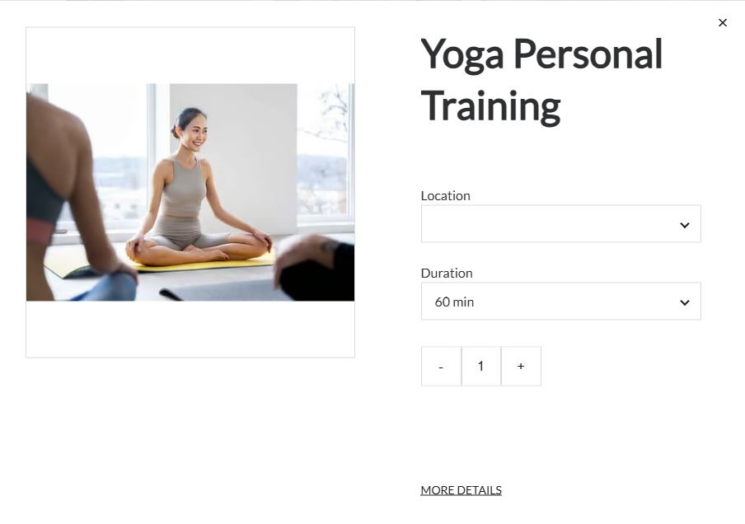
Home
Therapists
Book now
About us
Contacts
Profile
Sign out
Germany Mobile Spa
Deep Tissue Massage
Services
Our practitioners are available daily from 8.00am until 7.00pm. If requiring services after 7.00pm additional 200 Baht/hour will be added to each service.
Thai Massage
50.00€
The rejuvenating power of a Deep Tissue Massage, targeting deeper layers of muscle and connective tissue. With firm pressure and focused techniques, this treatment relieves chronic tension, eases tightness, and promotes recovery, leaving you feeling restored and revitalized.
60 minutes: 35.00 € 90 minutes: 50.00 € 120 minutes: 65.00 €
Relaxing Oil Massage
Deep Tissue Massage
Slimming Massage
Unter den Linden 12, 10117 Berlin
Jet Lag Massage
Myofascial Massage
Pregnancy Massage
90 min
Foot Massage
Foot Scrub
Attendants
- 4 +
Body Scrub
Facial Treatment
Preferred Therapist
Single
Yoga Personal Trainer
Male
Couple
Female
Groups
Next
Book
Manicure
No preference
Pedicure

Slide 10
Home
Therapists
Book now
About us
Contacts
Profile
Sign out
Germany Mobile Spa
Deep Tissue Massage
Services
Our practitioners are available daily from 8.00am until 7.00pm. If requiring services after 7.00pm additional 200 Baht/hour will be added to each service.
Thai Massage
50.00€
The rejuvenating power of a Deep Tissue Massage, targeting deeper layers of muscle and connective tissue. With firm pressure and focused techniques, this treatment relieves chronic tension, eases tightness, and promotes recovery, leaving you feeling restored and revitalized.
60 minutes: 35.00 € 90 minutes: 50.00 € 120 minutes: 65.00 €
Relaxing Oil Massage
Deep Tissue Massage
Slimming Massage
Unter den Linden 12, 10117 Berlin
Jet Lag Massage
Myofascial Massage
Pregnancy Massage
90 min
Foot Massage
Foot Scrub
Attendants
- 4 +
Body Scrub
Facial Treatment
Preferred Therapist
Single
Yoga Personal Trainer
Male
Couple
Female
Groups
Next
Book
Manicure
No preference
Pedicure

Slide 11
Home
Therapists
Book now
About us
Contacts
Profile
Sign out
Germany Mobile Spa
Deep Tissue Massage
Services
Our practitioners are available daily from 8.00am until 7.00pm. If requiring services after 7.00pm additional 200 Baht/hour will be added to each service.
Thai Massage
50.00€
The rejuvenating power of a Deep Tissue Massage, targeting deeper layers of muscle and connective tissue. With firm pressure and focused techniques, this treatment relieves chronic tension, eases tightness, and promotes recovery, leaving you feeling restored and revitalized.
60 minutes: 35.00 € 90 minutes: 50.00 € 120 minutes: 65.00 €
Relaxing Oil Massage
Deep Tissue Massage
Slimming Massage
Unter den Linden 12, 10117 Berlin
Jet Lag Massage
Myofascial Massage
Pregnancy Massage
90 min
Foot Massage
Foot Scrub
Attendants
- 4 +
Body Scrub
Facial Treatment
Preferred Therapist
Single
Yoga Personal Trainer
Male
Couple
Female
Groups
Next
Book
Manicure
No preference
Pedicure

Slide 12
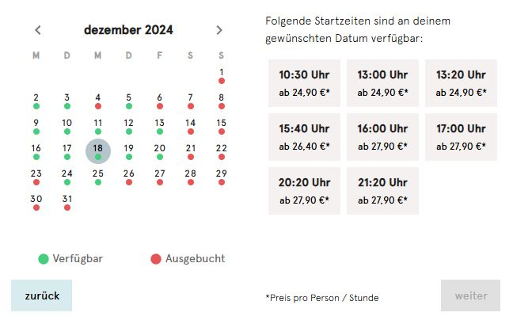
Home
Therapists
Book now
About us
Contacts
Profile
Sign out
Germany Mobile Spa
Services
Our practitioners are available daily from 8.00am until 7.00pm. If requiring services after 7.00pm additional 200 Baht/hour will be added to each service.
December
Thai Massage
The rejuvenating power of a Deep Tissue Massage, targeting deeper layers of muscle and connective tissue. With firm pressure and focused techniques, this treatment relieves chronic tension, eases tightness, and promotes recovery, leaving you feeling restored and revitalized.
60 minutes: 35.00 € 90 minutes: 50.00 € 120 minutes: 65.00 €
Relaxing Oil Massage
8:00 am
2:00 pm
8:00 pm
Deep Tissue Massage
Slimming Massage
10:00 am
4:00 pm
10:00 pm
Jet Lag Massage
Myofascial Massage
Pregnancy Massage
12:00 am
6:00 pm
Foot Massage
Foot Scrub
Body Scrub
Available
Booked out
Facial Treatment
Back
Pay
Book
Yoga Personal Trainer
Manicure
Book
Pedicure
Book

Slide 13
Home
Therapists
Book now
About us
Contacts
Profile
Sign out
Germany Mobile Spa
Services
Our practitioners are available daily from 8.00am until 7.00pm. If requiring services after 7.00pm additional 200 Baht/hour will be added to each service.
December
Thai Massage
The rejuvenating power of a Deep Tissue Massage, targeting deeper layers of muscle and connective tissue. With firm pressure and focused techniques, this treatment relieves chronic tension, eases tightness, and promotes recovery, leaving you feeling restored and revitalized.
60 minutes: 35.00 € 90 minutes: 50.00 € 120 minutes: 65.00 €
Relaxing Oil Massage
8:00 am
2:00 pm
8:00 pm
Deep Tissue Massage
Slimming Massage
10:00 am
4:00 pm
10:00 pm
Jet Lag Massage
Myofascial Massage
Pregnancy Massage
12:00 am
6:00 pm
Foot Massage
Foot Scrub
Body Scrub
Available
Booked out
Facial Treatment
Back
Pay
Book
Yoga Personal Trainer
Manicure
Book
Pedicure
Book

Slide 14
Home
Therapists
Book now
About us
Contacts
Profile
Sign out
Germany Mobile Spa
Services
Our practitioners are available daily from 8.00am until 7.00pm. If requiring services after 7.00pm additional 200 Baht/hour will be added to each service.
December
Thai Massage
The rejuvenating power of a Deep Tissue Massage, targeting deeper layers of muscle and connective tissue. With firm pressure and focused techniques, this treatment relieves chronic tension, eases tightness, and promotes recovery, leaving you feeling restored and revitalized.
60 minutes: 35.00 € 90 minutes: 50.00 € 120 minutes: 65.00 €
Relaxing Oil Massage
8:00 am
2:00 pm
8:00 pm
Deep Tissue Massage
Slimming Massage
10:00 am
4:00 pm
10:00 pm
Jet Lag Massage
Myofascial Massage
Pregnancy Massage
12:00 am
6:00 pm
Foot Massage
Foot Scrub
Body Scrub
Available
Booked out
Facial Treatment
Back
Pay
Book
Yoga Personal Trainer
Manicure
Book
Pedicure
Book

Slide 15
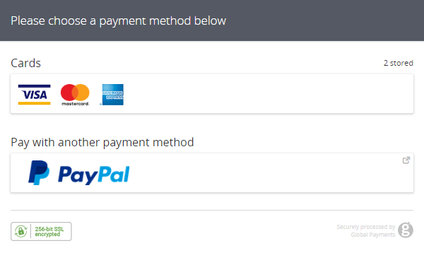
Home
Therapists
Book now
About us
Contacts
Profile
Sign out
Germany Mobile Spa
Services
Our practitioners are available daily from 8.00am until 7.00pm. If requiring services after 7.00pm additional 200 Baht/hour will be added to each service.
Thai Massage
The rejuvenating power of a Deep Tissue Massage, targeting deeper layers of muscle and connective tissue. With firm pressure and focused techniques, this treatment relieves chronic tension, eases tightness, and promotes recovery, leaving you feeling restored and revitalized.
60 minutes: 35.00 € 90 minutes: 50.00 €
Relaxing Oil Massage
Deep Tissue Massage
Slimming Massage
Jet Lag Massage
Myofascial Massage
Pregnancy Massage
Foot Massage
Foot Scrub
Body Scrub
Facial Treatment
Yoga Personal Trainer
Manicure
Book
Pedicure
(handled by APIs)
Book

Slide 16
Booking a service through the Booking Template
While logged in
Click to continue presentation

Slide 17
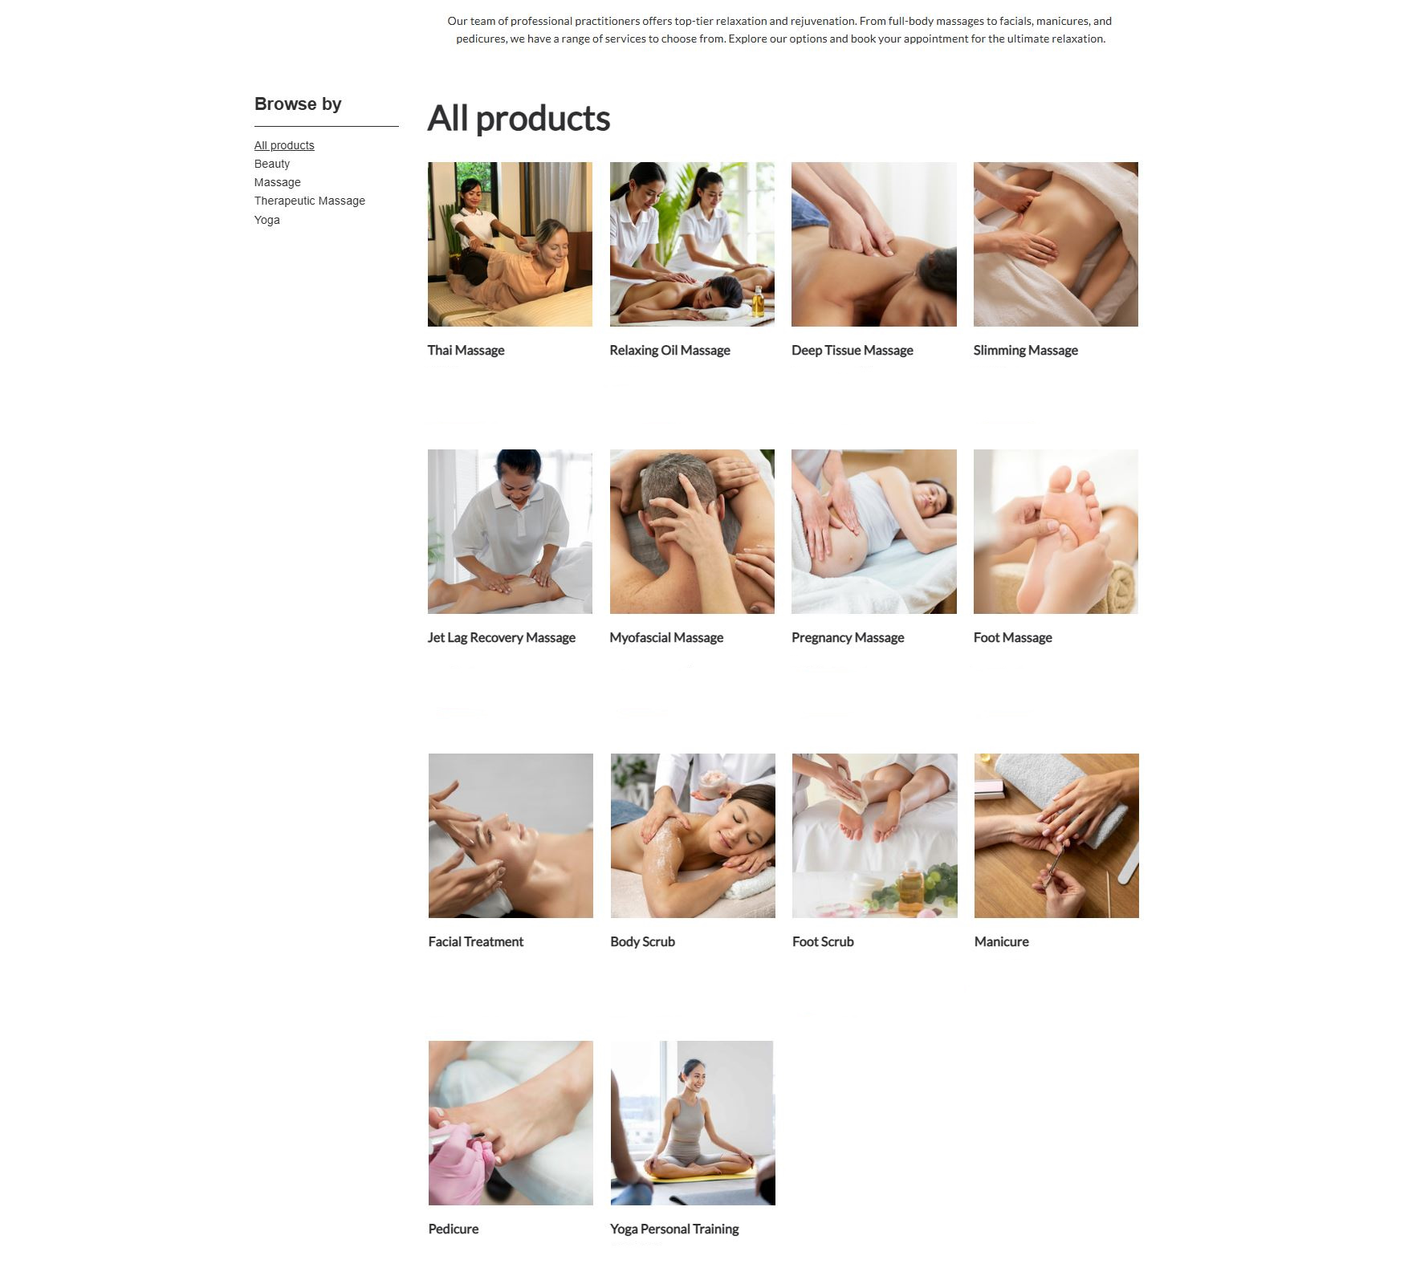
Home
Therapists
Book now
About us
Contacts
Profile
Sign out
Germany Mobile Spa
From 25€ From 25€ From 35€ From 50€
Book
Book
Book
Book
From 45€ From 35€ From 25€ From 25€
Book
Book
Book
Book

Slide 18
Home
Therapists
Book now
About us
Contacts
Profile
Sign out
Germany Mobile Spa
From 25€ From 25€ From 35€ From 50€
Book
Book
Book
Book
From 45€ From 35€ From 25€ From 25€
Book
Book
Book
Book

Slide 19
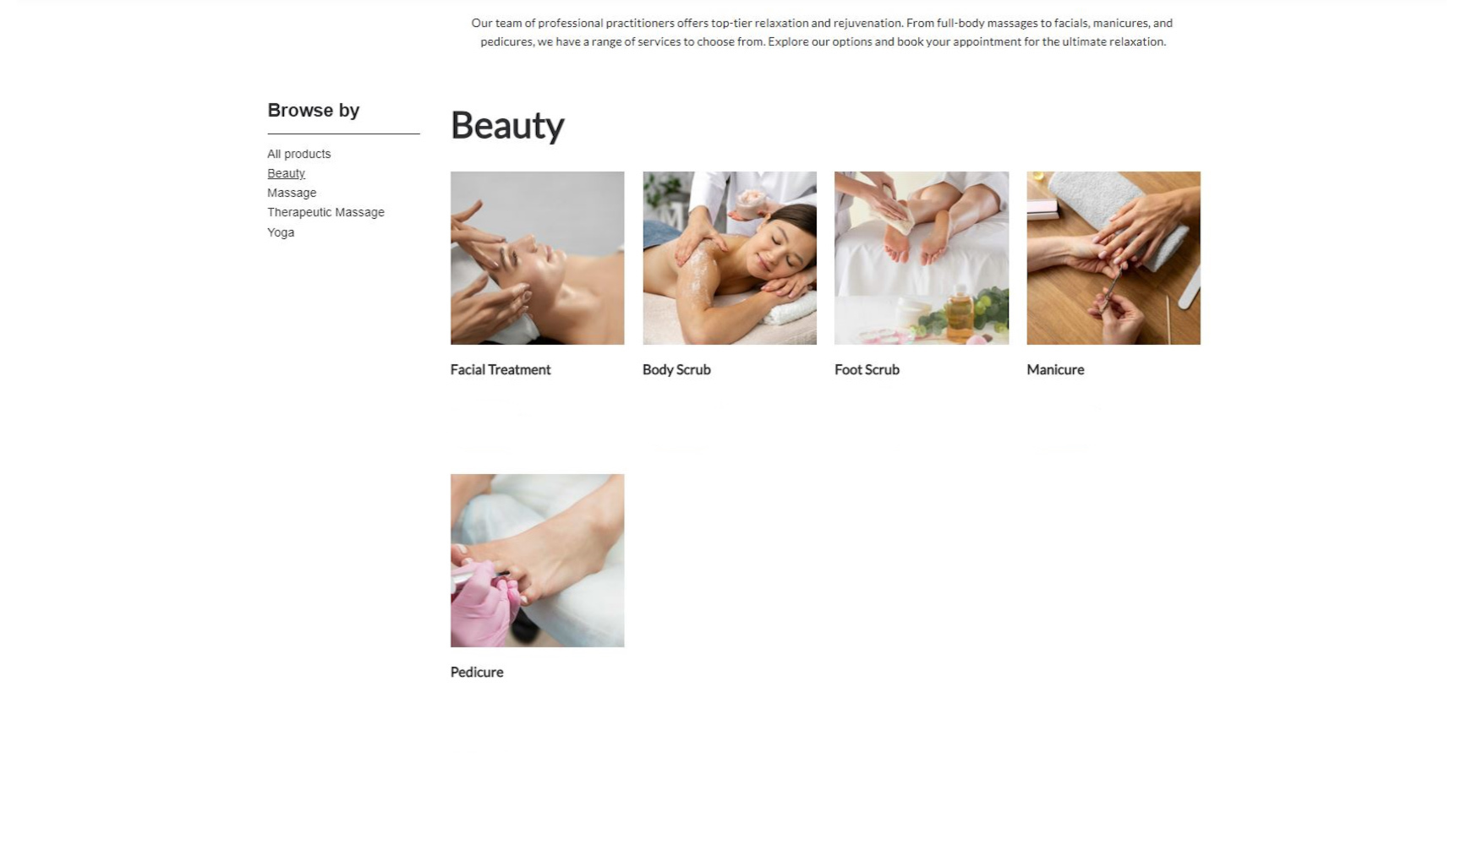
Home
Therapists
Book now
About us
Contacts
Profile
Sign out
Germany Mobile Spa
From 50€ From 35€ From 30€ From 25€
Book
Book
Book
Book
From 25€
Book

Slide 20
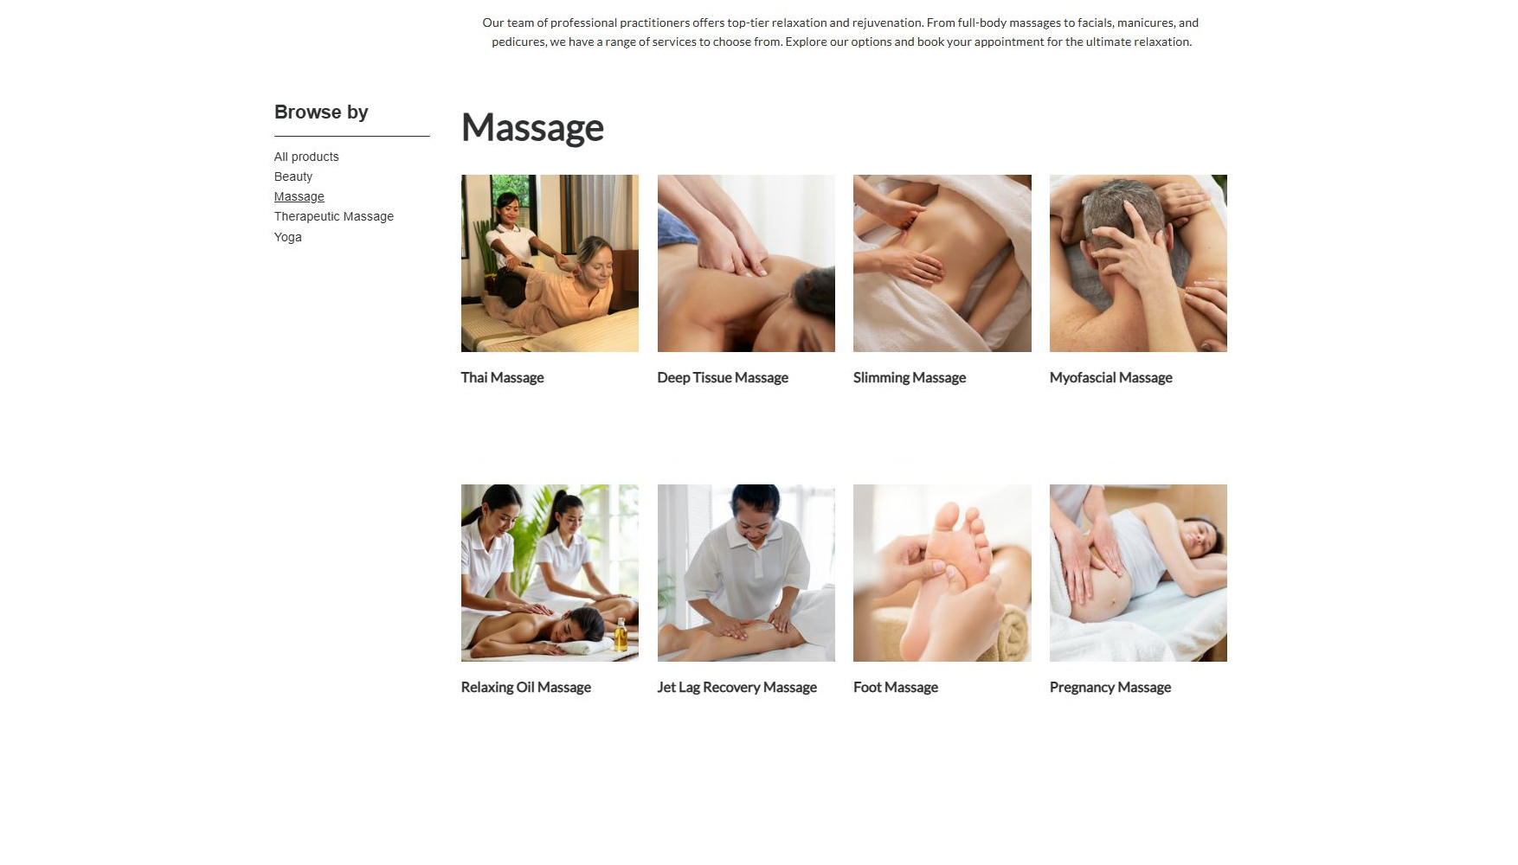
Home
Therapists
Book now
About us
Contacts
Profile
Sign out
Germany Mobile Spa
From 25€ From 35€ From 50€ From 35€
Book
Book
Book
Book
From 25€ From 45€ From 25€ From 25€
Book
Book
Book
Book

Slide 21
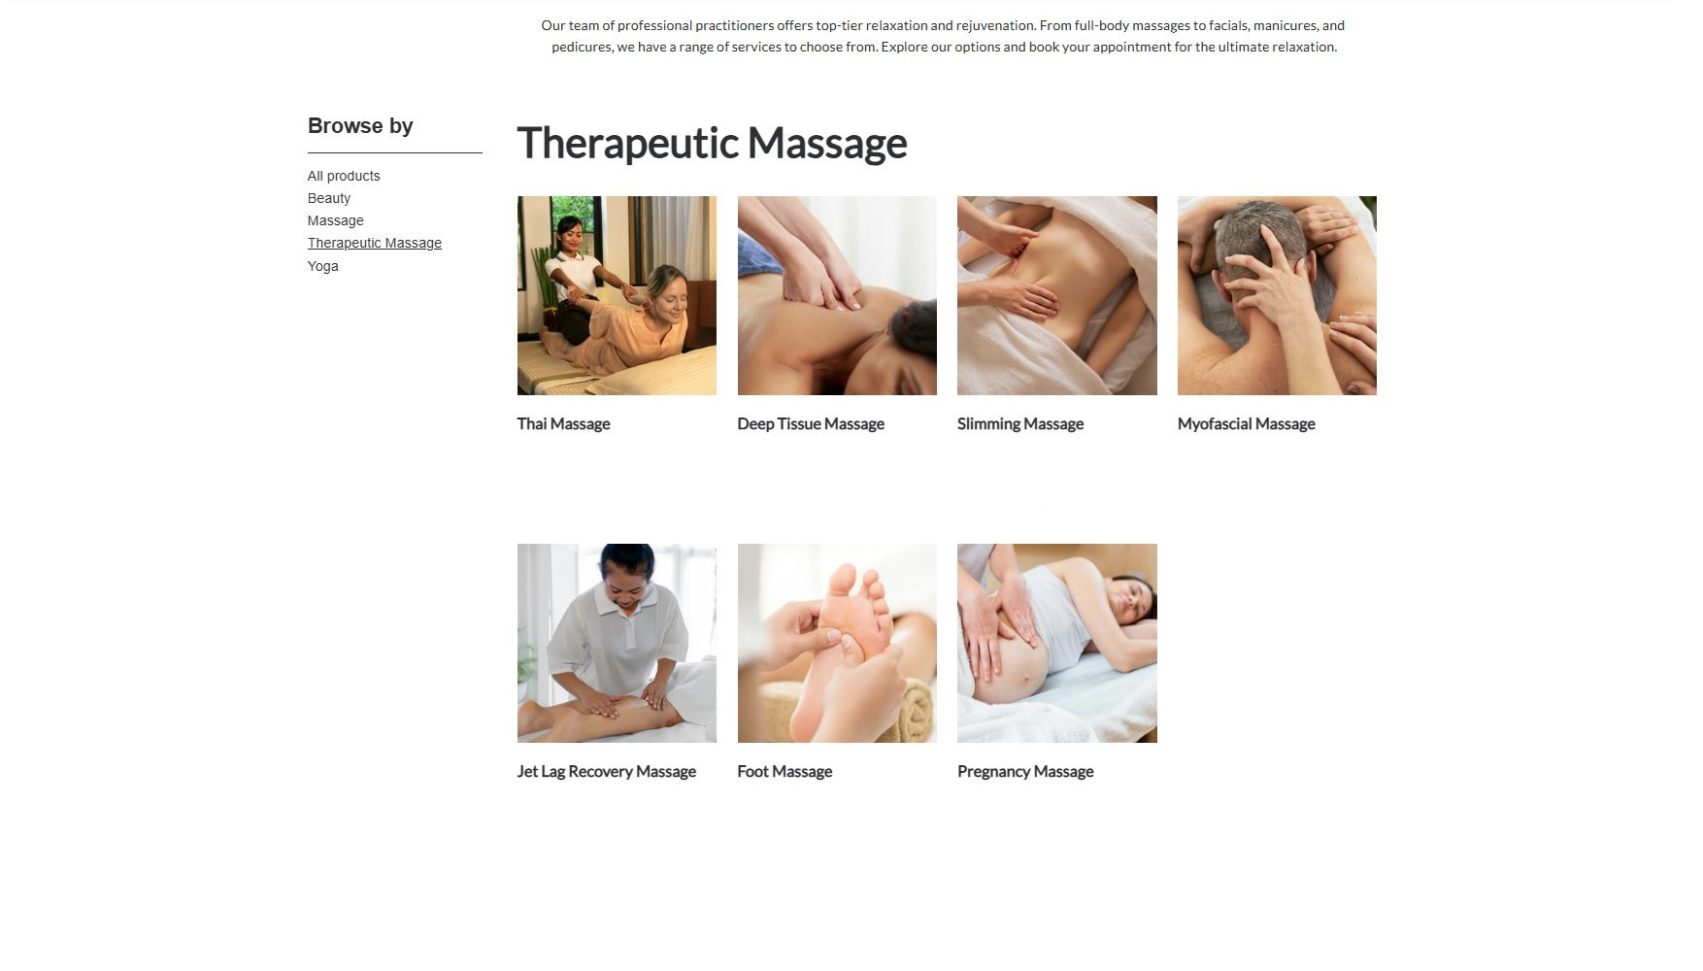
Home
Therapists
Book now
About us
Contacts
Profile
Sign out
Germany Mobile Spa
From 25€ From 35€ From 50€ From 35€
Book
Book
Book
Book
From 45€ From 25€ From 25€
Book
Book
Book

Slide 22
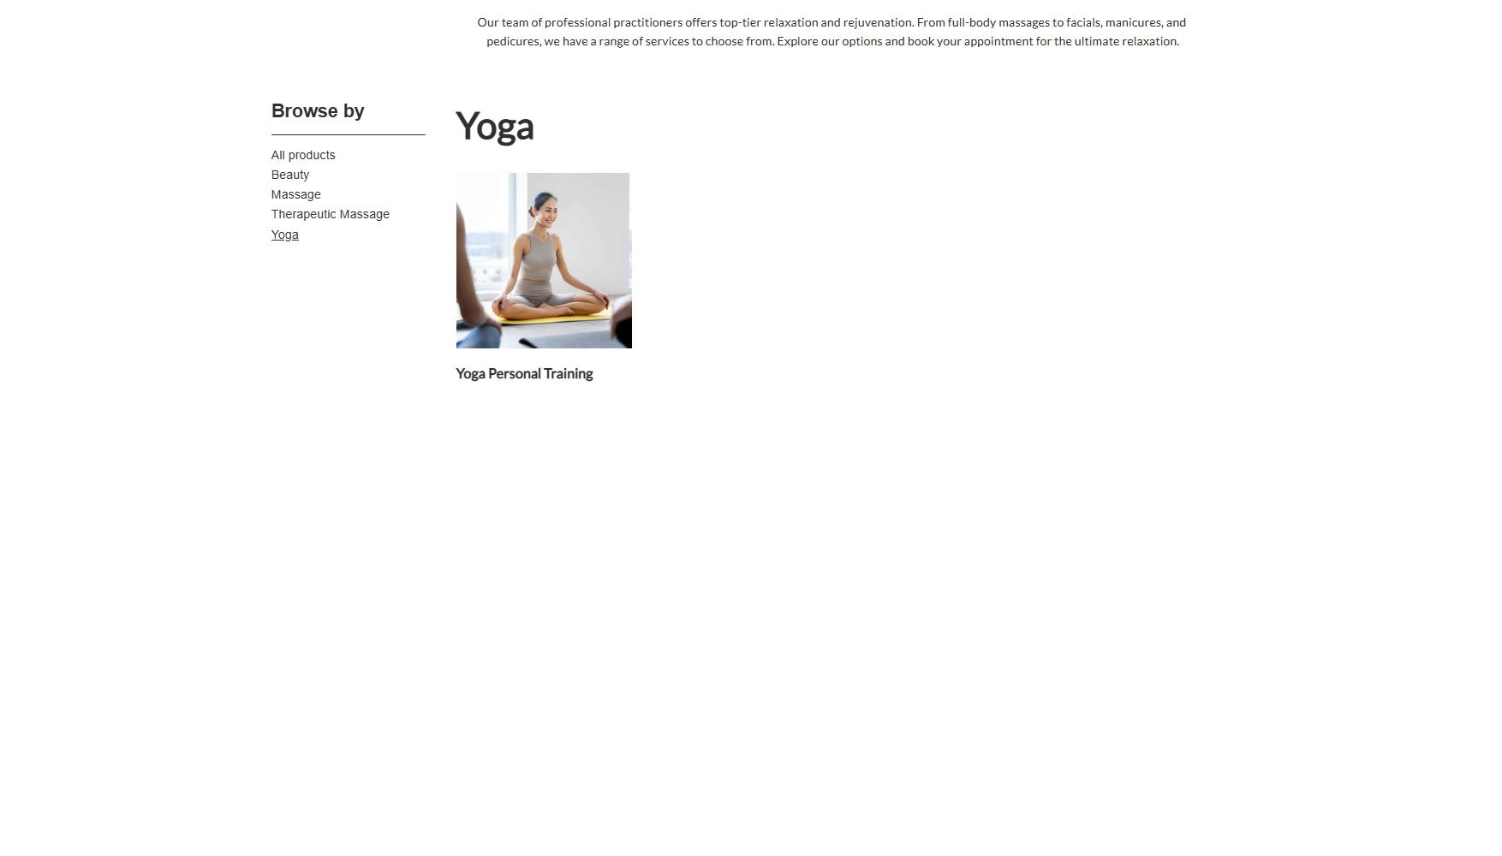
Home
Therapists
Book now
About us
Contacts
Profile
Sign out
Germany Mobile Spa
From 50€
Book

Slide 23
Home
Therapists
Book now
About us
Contacts
Profile
Sign out
Germany Mobile Spa
From 25€ From 25€ From 35€ From 50€
Book
Book
Book
Book
From 45€ From 35€ From 25€ From 25€
Book
Book
Book
Book
From 50€ From 35€ From 30€ From 25€
Book
Book
Book
Book
From 25€ From 50€
Book
Book

Slide 24
From 25€ From 25€ From 35€ From 50€
Book
Book
Book
Book
Home
Therapists
Book now
About us
Contacts
Profile
Sign out
Germany Mobile Spa
From 45€ From 35€ From 25€ From 25€
Book
Book
Book
Book
From 50€ From 35€ From 30€ From 25€
Book
Book
Book
Book
From 25€ From 50€
Book
Book

Slide 25
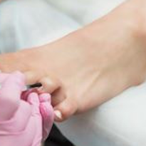
From 25€ From 25€ From 35€ From 50€
Book
Book
Book
Book
Home
Therapists
Book now
About us
Contacts
Profile
Sign out
Germany Mobile Spa
From 45€ From 35€ From 25€ From 25€
Book
Book
Book
Book
From 50€ From 35€ From 30€ From 25€
Book
Book
Book
Book
From 25€ From 50€
Book
Book

Slide 26
From 25€ From 25€ From 35€ From 50€
Book
Book
Book
Book
Home
Therapists
Book now
About us
Contacts
Profile
Sign out
Germany Mobile Spa
From 45€ From 35€ From 25€ From 25€
Book
Book
Book
Book
From 50€ From 35€ From 30€ From 25€
Book
Book
Book
Book
From 25€ From 50€
Book
Book

Slide 27

From 25€ From 25€ From 35€ From 50€
Book
Book
Book
Book
Home
Therapists
Book now
About us
Contacts
Profile
Sign out
Germany Mobile Spa
From 45€ From 35€ From 25€ From 25€
Book
Book
Book
Book
From 50€ From 35€ From 30€ From 25€
Book
Book
Book
Book
From 25€ From 50€
Book
Book

Slide 28
From 25€ From 25€ From 35€ From 50€
Book
Book
Book
Book
Home
Therapists
Book now
About us
Contacts
Profile
Sign out
Germany Mobile Spa
From 45€ From 35€ From 25€ From 25€
Book
Book
Book
Book
From 50€ From 35€ From 30€ From 25€
Book
Book
Book
Book
From 25€ From 50€
Book
Book

Slide 29
From 25€ From 25€ From 35€ From 50€
Book
Book
Book
Book
Home
Therapists
Book now
About us
Contacts
Profile
Sign out
Germany Mobile Spa
From 45€ From 35€ From 25€ From 25€
Book
Book
Book
Book
From 50€ From 35€ From 30€ From 25€
Book
Book
Book
Book
From 25€ From 50€
Book
Book

Slide 30
From 25€ From 25€ From 35€ From 50€
Book
Book
Book
Book
Home
Therapists
Book now
About us
Contacts
Profile
Continue
Sign out
Germany Mobile Spa
From 45€ From 35€ From 25€ From 25€
Book
Book
Book
Book
50.00€
From 50€ From 35€ From 30€ From 25€
Unter den Linden 12, 10117 Berlin
Book
Book
Book
Book
- +
Attendants
4
Preferred Therapist
Single
Male
Couple
Next
Female
Groups
No preference
From 25€ From 50€
Book
Book

Slide 31
From 25€ From 25€ From 35€ From 50€
Book
Book
Book
Book
Home
Therapists
Book now
About us
Contacts
Profile
Continue
Sign out
Germany Mobile Spa
From 45€ From 35€ From 25€ From 25€
Book
Book
Book
Book
50.00€
From 50€ From 35€ From 30€ From 25€
Unter den Linden 12, 10117 Berlin
Book
Book
Book
Book
- +
Attendants
4
Preferred Therapist
Single
Male
Couple
Next
Female
Groups
No preference
From 25€ From 50€
Book
Book

Slide 32
From 25€ From 25€ From 35€ From 50€
Book
Book
Book
Book
Home
Therapists
Book now
About us
Contacts
Profile
Continue
Sign out
Germany Mobile Spa
From 45€ From 35€ From 25€ From 25€
Book
Book
Book
Book
50.00€
From 50€ From 35€ From 30€ From 25€
Unter den Linden 12, 10117 Berlin
Book
Book
Book
Book
- +
Attendants
4
Preferred Therapist
Single
Male
Couple
Next
Female
Groups
No preference
From 25€ From 50€
Book
Book

Slide 33
From 25€ From 25€ From 35€ From 50€
Book
Book
Book
Book
Continue
Home
Therapists
Book now
About us
Contacts
Profile
Sign out
Germany Mobile Spa
From 45€ From 35€ From 25€ From 25€
Book
Book
Book
Book
December
50.00€
8:00 am
2:00 pm
8:00 pm
From 50€ From 35€ From 30€ From 25€
Unter den Linden 12, 10117 Berlin
10:00 am
4:00 pm
10:00 pm
Book
Book
Book
Book
12:00 am
6:00 pm
- +
Attendants
4
Available
Booked out
Back
Single
Pay
Couple
Pay
Groups
From 25€ From 50€
Book
Book

Slide 34
From 25€ From 25€ From 35€ From 50€
Book
Book
Book
Book
Continue
Home
Therapists
Book now
About us
Contacts
Profile
Sign out
Germany Mobile Spa
From 45€ From 35€ From 25€ From 25€
Book
Book
Book
Book
December
50.00€
8:00 am
2:00 pm
8:00 pm
From 50€ From 35€ From 30€ From 25€
Unter den Linden 12, 10117 Berlin
10:00 am
4:00 pm
10:00 pm
Book
Book
Book
Book
12:00 am
6:00 pm
- +
Attendants
4
Available
Booked out
Back
Single
Pay
Couple
Pay
Groups
From 25€ From 50€
Book
Book

Slide 35
From 25€ From 25€ From 35€ From 50€
Book
Book
Book
Book
Continue
Home
Therapists
Book now
About us
Contacts
Profile
Sign out
Germany Mobile Spa
From 45€ From 35€ From 25€ From 25€
Book
Book
Book
Book
December
50.00€
8:00 am
2:00 pm
8:00 pm
From 50€ From 35€ From 30€ From 25€
Unter den Linden 12, 10117 Berlin
10:00 am
4:00 pm
10:00 pm
Book
Book
Book
Book
12:00 am
6:00 pm
- +
Attendants
4
Available
Booked out
Back
Single
Pay
Couple
Pay
Groups
From 25€ From 50€
Book
Book

Slide 36
From 25€ From 25€ From 35€ From 50€
Book
Book
Book
Book
Continue
Home
Therapists
Book now
About us
Contacts
Profile
Sign out
Germany Mobile Spa
From 45€ From 35€ From 25€ From 25€
Book
Book
Book
Book
Continue
50.00€
From 50€ From 35€ From 30€ From 25€
Unter den Linden 12, 10117 Berlin
Book
Book
Book
Book
Pay
(handled by APIs)
From 25€ From 50€
Book
Book

Slide 37
The end
Click to exit

